Slide 1

San Antonio City Council Productivity Michael Grogan LDL776

Slide 2
Objective
How well does our city council function?
How often do they vote on issues?
Are they a polarized in their voting patterns?
How have the answers to these questions changed over the last 20 years?
F

Slide 3
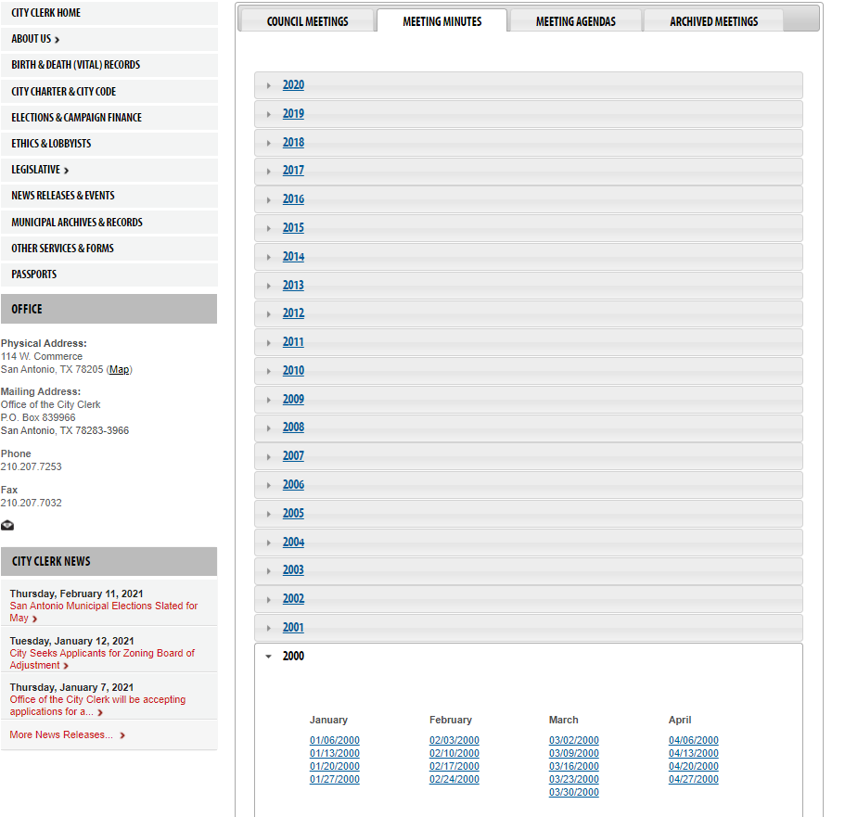
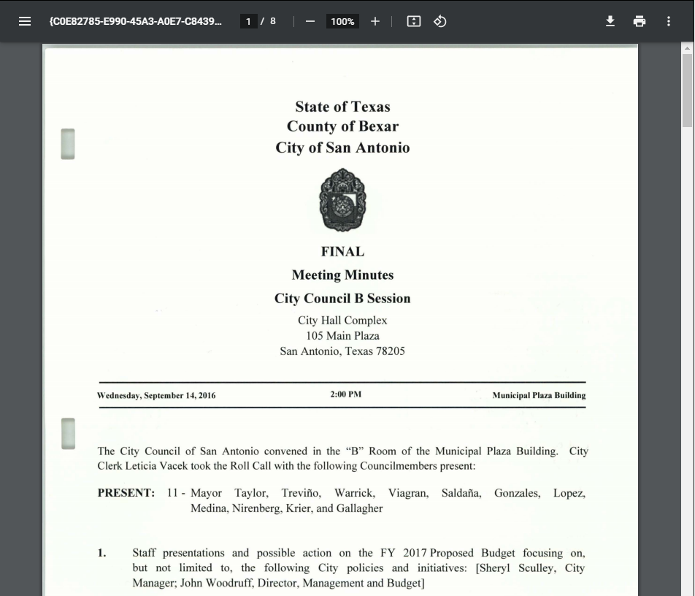
Source
San Antonio has scanned PDFs of every City Council meeting since 2000
https://www.sanantonio.gov/Clerk/Legislative/City-Council-Agendas-Minutes
F

Slide 4
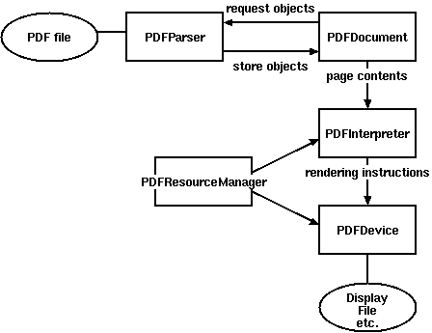
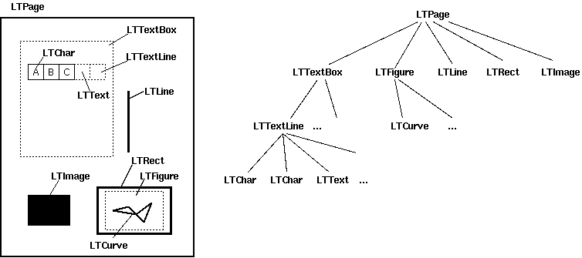
Converting PDF to Text
Some PDFs have clearly defined information coded into the file itself (IRS forms where you can type in the boxes)
Not for the SACC Minutes, which are basically scanned pictures saved as PDF
https://pdfminer-docs.readthedocs.io/

Slide 5
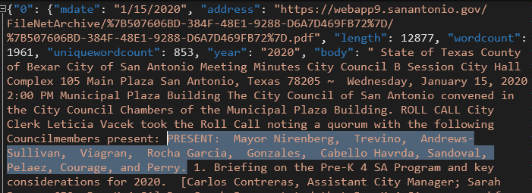
Utilizing Text
Depending on the quality of the scan, and the consistency of the language used, we can catalogue who was present at a given meeting, the issues voted on, and the results of those votes

Slide 6
Targeted Data
Members present at meeting (Roll Call)
Number of votes taken during meeting
Number of members voting Aye per vote
These data points are averaged to give a single value per meeting

Slide 7
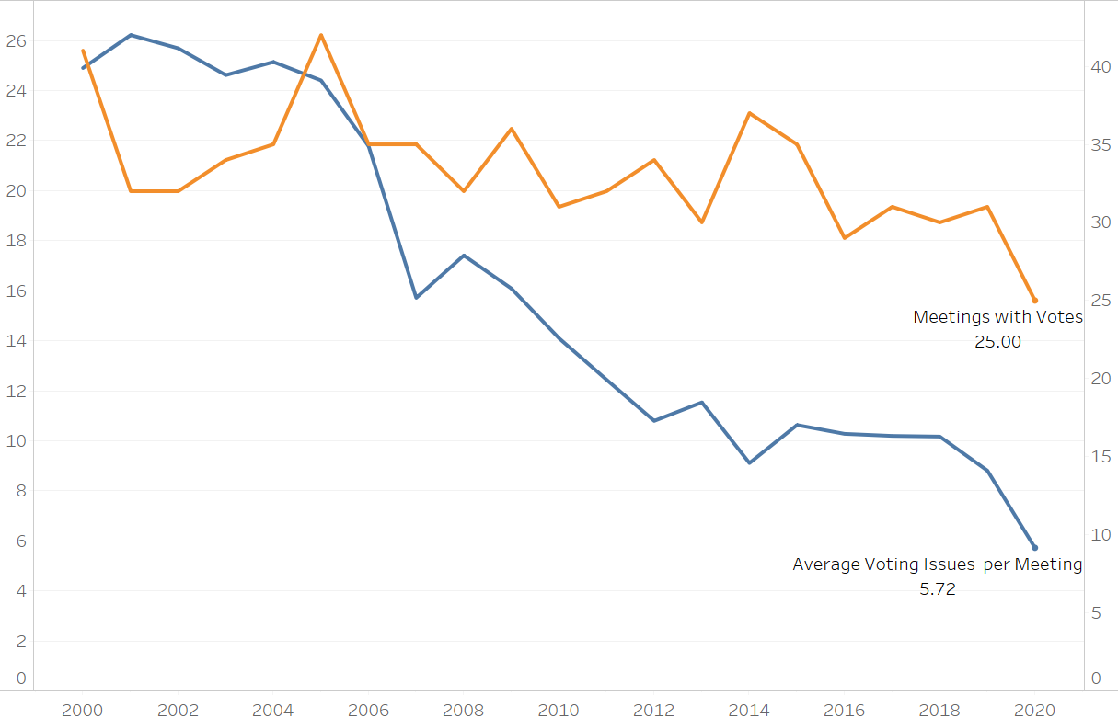
Voting Issues per Meeting

Slide 8
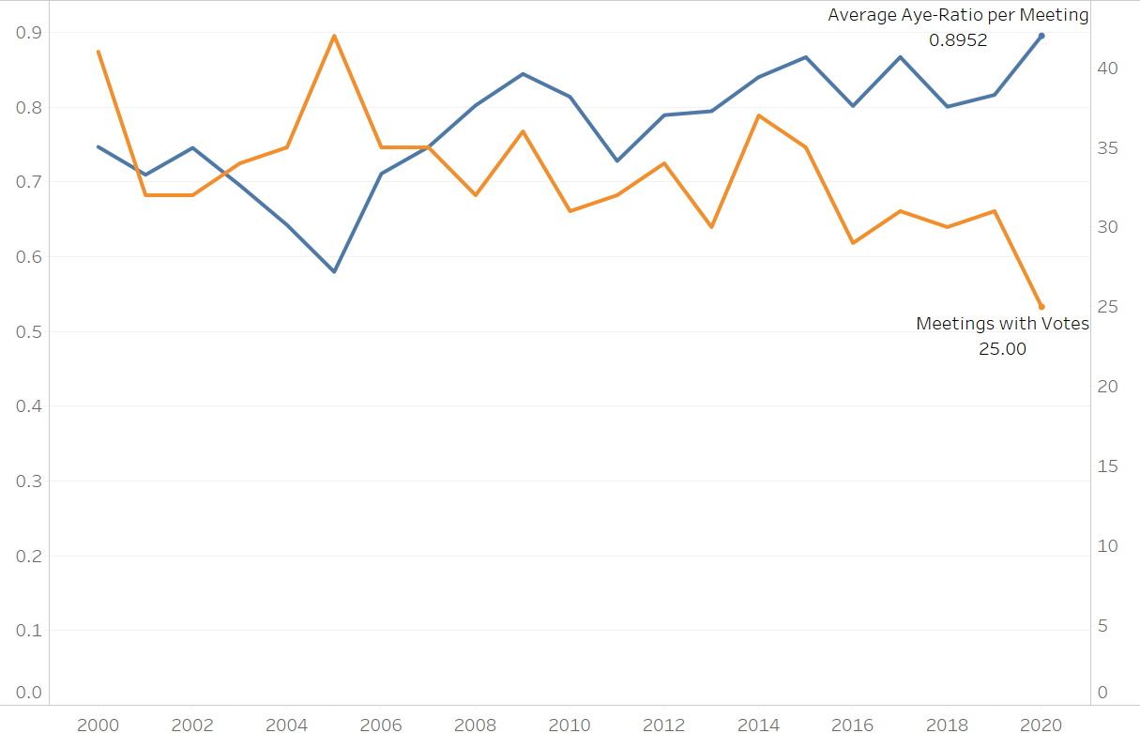
Margin of Passage (Ayes to Non-Ayes)

Slide 9
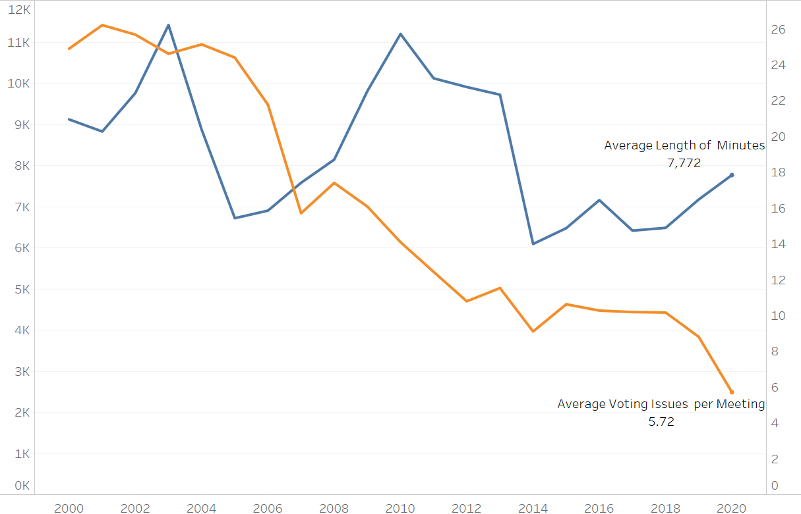
Amount of Content vs Voting Issues

Slide 10
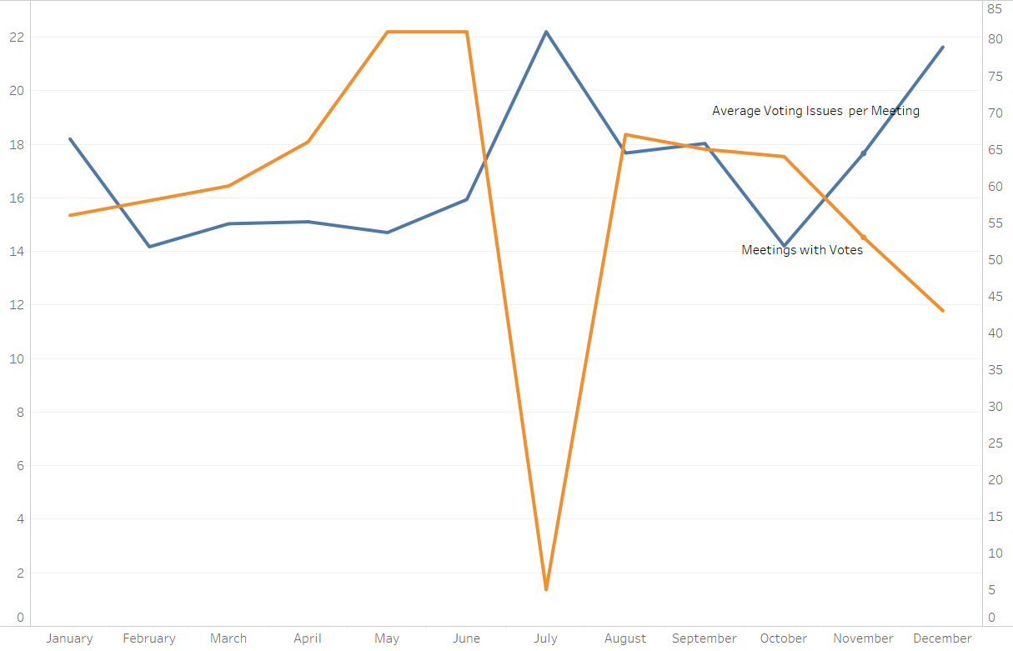
By Month

Slide 11
Conclusions
In general, the number of meetings where at least one vote is held and the number of votes held in those meetings have both decreased since 2000.
Are they being more efficient with their motions? More votes doesn’t mean all the votes are consequential
One explanation is that more of the meetings are being devoted to hearing community input or discussing a topic rather than vote on anything

Slide 12
Conclusions
Consistently high and even increasing is the ratio of councilmembers voting Aye on a given measure.
This would imply that either the council is a generally agreeable group or possibly that a vote is not taken on an agenda item unless they know that it is going to pass

Slide 13
Challenges
The limitation to the entire process is the quality of the text produced by the PDF>Text converter
Several libraries were tested (PyPDF2, PDFPlumber, PDFMINER) and none were ideal
Processing large numbers of PDFs is time-intensive so testing is best done on small batches, HOWEVER, changes over the years in the syntax of phrases used to identify target information was impossible to predict and could only be discovered after larger, longer batches.
F

